Slide 1







Development Team
BI Jiajun
CHEN Xuan
RUAN Keda
SUN Lei
ZHOU Yuqian
CostBox
Course Project
COMP3111
Software Engineering
The most convenient
Accounting
Tool
Proposal Pre

Slide 2

Content
Project Introduction
Function Analysis
Advantage Analysis
Summary

Slide 3
Project Introduction
Proj Name: CostBox 1.0
Category: Accounting Tool
Problems solved:
Annoyed Attributes Adding
& Data Confusion
Object: Convenient & Handy

Slide 4
Function Analysis
Accounting
Editing & Showing
Bill Generating
Info. Sharing

Slide 5
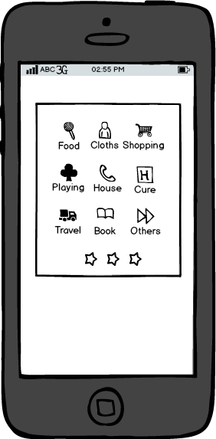
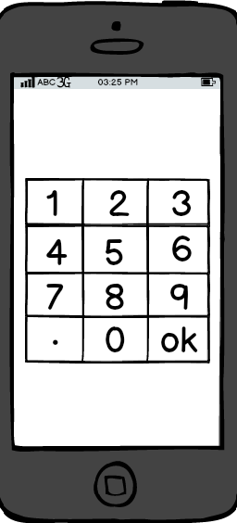

Function Analysis
Accounting
3 Secs!
No.2
Pull down
No.3
No.1
Choose One
Input Value

Slide 6
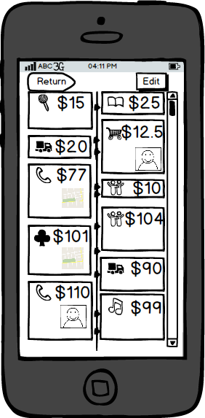
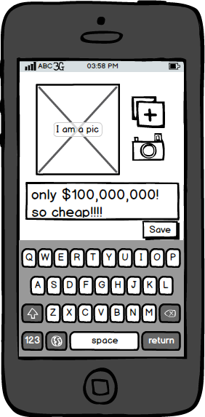
Function Analysis
Edit & Show
Cubic
Cubic
For each item, you can:
Add pictures
& comments
& Location(GPRS)
Time axis shown

Slide 7
Function Analysis
Bill Generating
Chart Generating
Table Generating

Slide 8
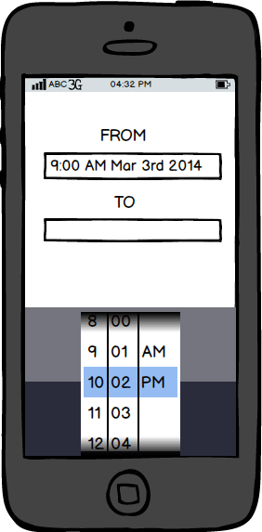
Function Analysis
Bill Generating
Choose items
or
Set the
time period

Slide 9
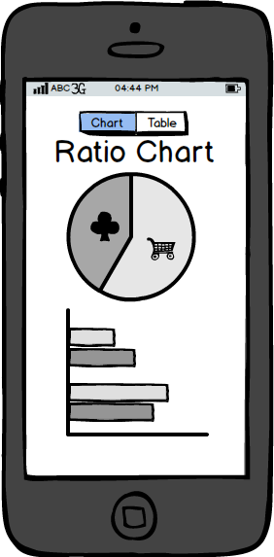
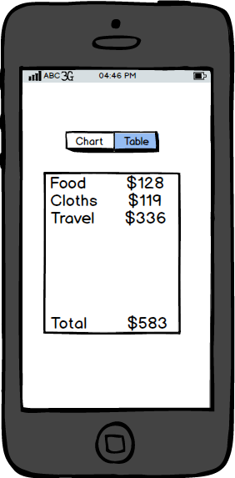
Function Analysis
Bill Generating
Chart
or
Table

Slide 10
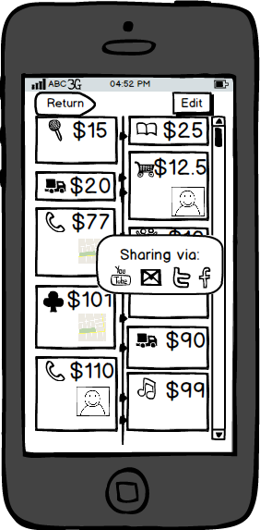

Function Analysis
Sharing
I cost 95 dollars on food. Kill me!!
Connected to SNS

Slide 11





Function Analysis
Additive Functions
Currency included
Money-saving Alert
Items searching

Slide 12
Advantage Analysis
Handier to add items
Multi dimension Record
Clearer to summarize
Faster to share

Slide 13
Summary
Challenges
Time axis design
Gestures building
Database setting up
. . .

Slide 14

CostBox 1.0
Thanks so much！

